Slide 1

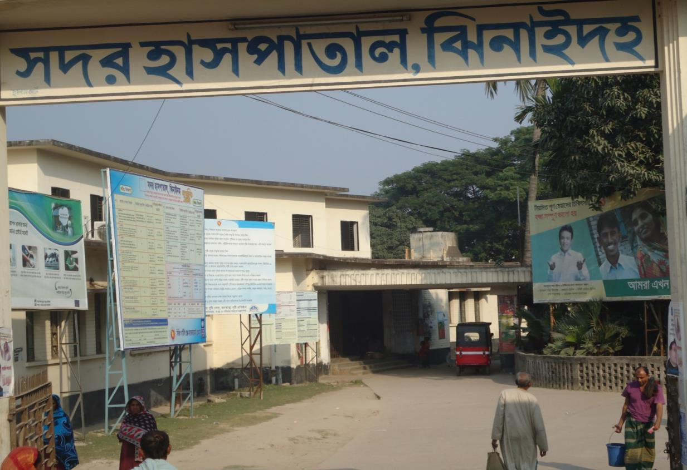
SADAR HOSPITAL, JHENAIDAH

Slide 2
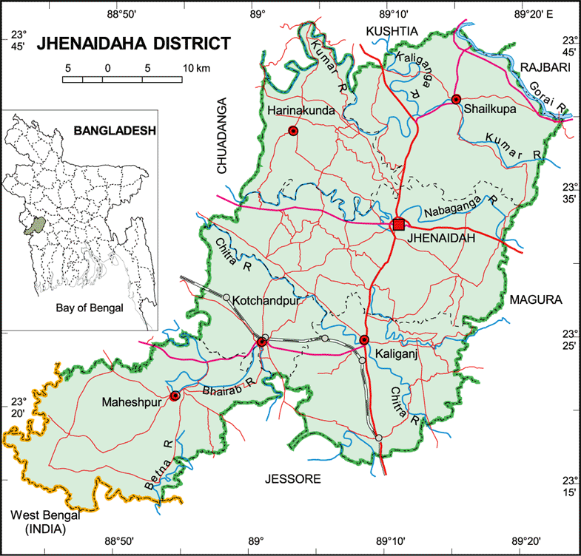

Slide 3
Comparative data of health facilities of different country of the world
SL NO | Country | Per capita health Expenditure per year by Govt ($) | Doctors per 10000 Population | Nurse per 10000 Population
01 | USA | 4437 | 24 | 98
02 | UK | 2919 | 27 | 101
03 | Japan | 2644 | 21 | 41
04 | Malaysia | 356 | 9 | 33
05 | Sri Lanka | 66 | 5 | 19
06 | India | 39 | 6 | 10
07 | Pakistan | 23 | 8 | 6
08 | Nepal | 22 | 8 | 6
09 | Bangladesh | 19 | 3 | 3

Slide 4
Background History of Jhenaidah Sadar Hospital
  Jhenaidah Sadar Hospital was established in 1968 as Sub-Division Hospital and became functioning from December 1970.
  From February 1984 recognized as District Sadar Hospital.
  In 1994 upgrade to 100 Bedded Hospital without manpower & infrastructure.
  In May 2005, Infrastructure of 100 Beded Hospital Completed
  TQM activities started in January 2011 and effectively in May 2012.
  In 9 February, 2014, 5S KIZEN – TQM program started by DGHS & SMPP JICA.
  In August 2014 post of hundred bedded manpower has been created but not posted yet.

Slide 5
Sadar Hospital, Jhenidah
Health, populaton and Nutrition Targets for the SFYP -1
Sl | Indicators | Base value with year | FY 2015
 | Impact / Outcome
1. | Life Expectancy | 66.6 ( SVRS 2007) | 70
2. | Population Growth Rate | 1.40 ( SVRS 2007) | 1.3
3. | Maternal mortality Ratio (MMR ) per 100000 live births | 194 ( BMMS2010) | 143
4. | Neonatal Mortality Rate ( per 1000 live births) | 37 ( BDHS 2007 | 27
5. | Infant Mortality Rate ( per 1000 live births ) | 52 ( BDHS 2007) | 31
6. | Under 5 mortality Rate ( per 1000 live births) | 65( BDHS 2007) | 50
7. | Malaria mortality ( per 100000 population ) | 4.4 | 2.2
8. | Maintain low prevalence of HIV | <1% | <1%
9. | Prevalence of Night blindness among pregnant women | 2.90% | 1%
10. | Underweight of Under 5 children 16-59 months ) | 41%( BDHS 2007) | 33%
11. | Stunting of under 5 children (16-59 months) | 43%( BDHS 2007) | 25%
12. | Total fertility rate ( TFR) | 2.7( BDHS 2007) | 2.2

Slide 6
Sadar Hospital, Jhenidah
Health, populaton and Nutrition Targets for the SFYP -2
Sl | Indicators | Base value with year | FY 2015
 | Output
13. | Contaceptive prevalence Rate ( CRP ) | 55% ( BDHS 2007) | 74%
14. | Permanent & Long acting FP ( of CPR ) | 7.3% ( BDHS 2007) | 20%
15. | TB case detection rate | 73% (NTP 2008) | 75%
16. | TB cure rate from | 92% ( NTP 2008) | 95%
17. | Births attended by skilled health personnel | 26.5% ( UESD 2010) | 50%
18. | Facility level delivery | 15% ( BDHS 2007) | 40%
19. | ANC coverage ( 4 visits ) | 20.6% ( BDHS 2007) | 50%
20. | PNC coverage ( Mother ) | 21.3( BDHS 2007) | 50%
21. | PNC coverage ( children ) | 21.9% ( BDHS 2007) | 50%
22. | Met need for EOC services | 22.43% ( BDHS 2007) | 80%
23. | TT coverage ( Children Protected at birth from tetanus ) | 93%(CES 2008) | 95%
24. | Valid coverage of full immunized children | 75.2% (CES 2008) | 90%
25 | Immunization of 1 year old children against Measles | 83%(CES.2008) | 90%
26 | VAC coverage ( 6m -6y) | 98%-100% | 98%-100%
27 | Postnatal VAC supplementation | 29% | 80%
28 | Severe anemia ( Children ) | 64% | 50%
29 | Severe anemia ( Pregnant women ) | 46% | 40%
30 | Exclusive breast feeding of children ( less than 6 months) | 42% | 80%

Slide 7
Health Profile of Jhenaidah District- 2014
Total population : 1857149
Total Pregnant : 38074
Total Live birth : 36465
Total Under five children : 222120
Total Upazila : 06
Total Paurasava : 06
Total Union : 67
Total Village : 1271
Govt. Health Institution :
Sadar Hospital : 01
Total Health Complex : 05
Total H&FWC/ RD (57+13) : 70
Community Clinic : 167
NTC : 01
IHT : 01
MCWC : 01
MATS : 01
Sishu Hospital : 01
ORS Preparation Plant : 01
Non-Govt. Health Institution :
Diabetic Hospital : 01
Eye Hospital : 01
Non-Govt. Clinic (Redg.) : 114

Slide 8
Sadar Hospital, Jhenaidah
Important post of Human Resources
Serial No. | Person | Post | Vacant
01 | Doctor | 40 | 25
02 | Nurse | 48 | 02
03 | Laboratory Technician | 02 | 01
04 | MLSS | 10 | 0
05 | Ward boy | 03 | 03
06 | Ayah | 03 | 03
07 | Cleaner | 08 | 01
08 | Guard | 03 | 03
09 | Gardener | 01 | 01
10 | Electrician | 01 | 01
11 | Trolley man | 00 | 00
12 | Others
 | Total | 151 | 50

Slide 9
Jhenaidah Sadar Hospital, Jhenaidah
KAIZEN Works Summary
Before Kaizen Situation
Inadequate Documentation and Reporting System.
2. Inadequate EOC Services.
3. Inadequate Overall Cleanliness.
4. Less Community Participation and No initiative of Local Resource Mobilization for Hospital Improvements (No post of ayah, ward boy, guard, gardener, trolley man and electrician, cleaner is only 7).
5. Less coordination with local administration and community leaders .
After Kaizen Situation
Improved Documentation and Reporting System
2. Improved EOC Services
3. Improved Overall Cleanliness
4. Significant Community Participation and Effective Local Resources Mobilization for Hospital Improvements (Arrange 51 manpower ayah, ward boy, guard, gardener, trolley man and electrician, cleaner).
5. Strong coordination with local administration and community leaders .

Slide 10
Jhenaidah Sadar Hospital, Jhenaidah
KAIZEN Works Summary -2
Before Kaizen Situation
.
6. Limited human resources specially cleaner , guard , gardener , ayah , ward boy , trolley man and electrician .
7. Demoralized environment , maximum 4th class employees were involved in corruption .
8. Insequred hospital for the staff and hospital as a whole .
9. Weak management system .
10. Butification of the hospital was neglected .
After Kaizen Situation
6. 51 man power supported by the community .
7. Developed moralized environment. Revenue income is increased .
8. Security is insured by the involvement of local MP, Mayor, DC and SP .
9. Improve management system .
10.Over all butification of the hospital improved .

Slide 11
Sadar Hospital, Jhenaidah
Emergency, Out door & Indoor Service 1998 to 2014
Sl No | Year | Emergency Patients | Out door Service | indoor Service | Bed occupancy rate
01 | 1998 | 16733 | 65062 | 12973 | 126%
02 | 2011 | 28855 | 141999 | 22435 | 146%
03 | 2012 | 30001 | 141069 | 22951 | 143%
04 | 2013 | 30281 | 162510 | 24643 | 165%
05 | 2014 | 35186 | 198682 | 27905 | 180%

Slide 12
Sadar Hospital, Jhenaidah
Comparative Data of EOC services in April,2012, April 2013 & April, 2014 at Jhenaidah Sadar Hospital
1000
909
900
800
700
600
517
514
500
437
400
300
275
263
170
201
200
100
84
78
34
55
0
Admission
Total Delivery
C. Section
ANC

Slide 13
Sadar Hospital, Jhenaidah
Comparative Data of EOC service of 4 best performing District Hospital of Khulna Division in 2014
Sl No | Year | ANC Services | Admitted Patient | Type of Delivery |  |  |  | PNC
 |  |  |  | NVD | ASST DEL | CS | Total
01 | 250 bed Hospital, Jessore | 12482 | 6323 | 1659 | 32 | 1583 | 3274 | 2023
02 | 100 bad Jhenidah Sador Hospital | 10811 | 6095 | 1924 | 21 | 941 | 2886 | 3729
03 | 250 bed Hospital, Khustia | 5029 | 6323 | 1585 | 32 | 907 | 2524 | 2728
04 | 100 bed Sathkhira Sadar Hospital | 3798 | 3422 | 993 | 14 | 910 | 1917 | 2427

Slide 14
Sadar Hospital, Jhenaidah
Development in EOC Service in Jhenaidah.
Introduce Labour Admission Register, Labour Ward Admission Form, Separate Discharge Form.
Starting of ANC & PNC corner and Arrange a Room for Medical Officer.
NO. of EOC Bed increase from 10 to 21 though on EOC bed only 5.
Improve EOC Operation Theater.
Moral based environment with 12 (twelve) workers supported by community donors.
EOC Operation activities extended from 8 A.M. to 2 P.M to 8 P.M.
Ensuring Rational use of drugs in EOC ward.
Provision of Mobile Phone in EOC ward no. 01857935012.
Shoe-free environment for infection control.
The center is used as a effective training center for SBA, Nursing student, Mid-wifiry.

Slide 15
Sadar Hospital, Jhenidah
EOC Service 1998 to 2014
Sl No | Year | ANC Services | Admitted Patient | Complications | Type of Delivery |  |  |  | PNC | Maternal Death
 |  |  |  |  | NVD | ASST DEL | CS | Total
01 | 1998 | 257 | 1364 | 542 | 951 | - | 155 | 1106 | - | 18
02 | 2011 | 1354 | 3906 | 1191 | 1912 | 33 | 430 | 2375 | 2140 | 1
03 | 2012 | 2268 | 4261 | 1934 | 1784 | 44 | 551 | 2379 | 2467 | 3
04 | 2013 | 7096 | 5445 | 3153 | 1783 | 28 | 985 | 2796 | 3606 | 3
05 | 2014 | 10811 | 6095 | 3700 | 1924 | 21 | 941 | 2886 | 3729 | 3

Slide 16
Sadar Hospital, Jhenidah
Operation Service 1998 to 2014
Sl. No. | Year | Major | Minor | Total
01 | 1998 | - | - | 1089
02 | 2011 | 780 | 4857 | 5629
03 | 2012 | 977 | 5433 | 6410
04 | 2013 | 1294 | 4923 | 6217
05 | 2014 | 1339 | 4512 | 5851

Slide 17
Comparative data of revenue income in August 2013 & August 2014
Sadar Hospital, Jhenaidah
Sl No. | Source Of Income | Taka (Aug 2013) | Taka (Aug 2014)
01 | Emergency & Outdoor | 61,230 | 94,175
02 | Paying cabin & paying bed | 61,500 | 1,02,500
03 | X-Ray, ECG, Blood bank, Pathology | 53,105 | 1,60,017
04 | Ambulance | 1,05,180 | 1,34,960
05 | Operation Charge | 19,000 | 43,000
06 | Patient admission Charge | 14,960 | 20,180
 | Total | 3,14,975 | 5,54,832

Slide 18
Comparative data of revenue income in Jhenaidah district in 2013 & 2014
Sadar Hospital, Jhenaidah

Slide 19
Sadar Hospital, Jhenaidah
Community Support System in Sadar Hospital
51 manpower (Cleaner 18, Aya & wardboy 19, Guard 6, Volunteer 5, Trolley man 3 ) get 2000 Tk per month per month per person. is supported by the community. Among them, 13 manpower were supported by doctors.
MP of Jhenaidah 2 donated 14 manpower support with continuous monitoring system in the hospital.
Mayor of Jhenidah Paurshava plays a major role in cleanness of the outer environment of the Hospital and repaired the boundary wall and made 4 dustbins with a cost of nearly one lac taka, and support 3 man power
Retired Joint secretary Mir Sahabuddin donated a generato for 24 hours OT service with a cost of nearly 33 thousands taka.
Chairman of Zahedee foundation donates 10 manpower support and an intercom system with a cost of nearly two lac taka.
Mr. Anisur Rahman (Khoka) (Previous chairman, Jhenaidah Paurshava) donates one man power support and also support for shoe free environment.
UP Chairman, Harishonkorpur, Jhenidah repairs 3 benches for seating of EOC outdoor patient.
Some of the Pharmaceuticals help in forms and discharge certificate and seating arrangement.

Slide 20
Important 4th class human resource of Jhenaodah Sadar Hpspital
Serial No. | Person Posted | Duration of Work (In hour) | Aya /Wardboy/MLSS | Cleaner | Total
01 | EOC Ward | 24 Hours | 03 | 03 | 06
02 | Female Surgery | 24 Hours | 03 | 03 | 06
03 | Female Medicine & Pediatric | 24 Hours | 03 | 03 | 06
04 | Male Medicine | 24 Hours | 03 | 03 | 06
05 | Male Surgery | 24 Hours | 03 | 03 | 06
06 | Dirrhoea Ward | 24 Hours | 03 | 03 | 06
07 | G. OT. | 24 Hours | 04 | 01 | 05
08 | EOC OT | 24 Hours | 00 | 00 | 00
09 | Emergency | 24 Hours | 04 | 00 | 04
10 | Outdoor |  | 00 | 03 | 03
11 | Trolley Man | 24 Hours | 03 | 00 | 03
12 | Drain + Campus |  | 00 | 02 | 02
13 | Guard (EOC) |  | 03 | 00 | 03
14 | Gardener + Campus Guard | 16 Hours | 03 | 00 | 03
15 | Receptionist, Pharmacy, Store |  | 02 | 00 | 02
16 | Blood Bank | 24 Hours | 03 | 00 | 03
17 | X-Ray, USG |  | 02 | 00 | 02
18 | Superintendent |  | 01 | 00 | 01
19 | Consultants, Nursing Super |  | 02 | 00 | 02
20 | RMO |  | 01 | 00 | 01
21 | Office, Outdoor |  | 04 | 00 | 04
22 | Outdoor Ticket Counter |  | 03 | 00 | 03
23 | Volunteer (Nursing Aid) | 24 Hours | 04 | 00 | 04
 | Total |  | 57 | 24 | 81
 | Govt. Manpower Support |  | 12 | 7 | 19

Slide 21
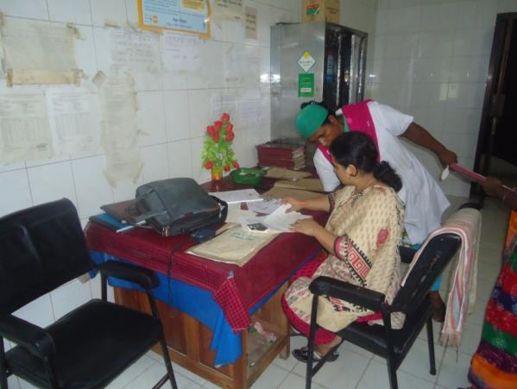
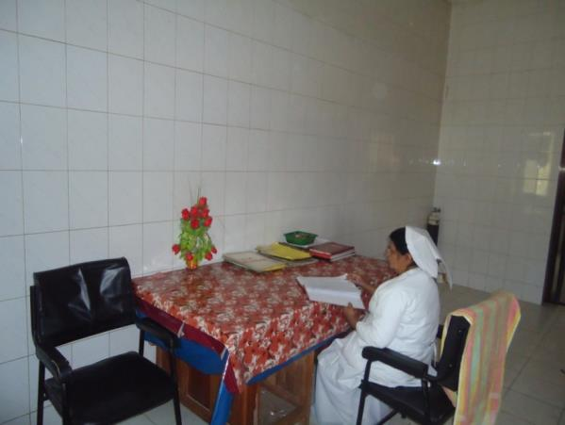
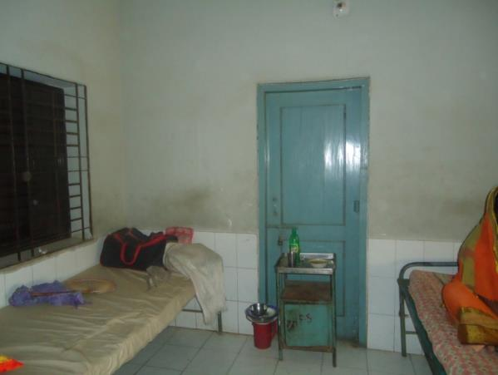
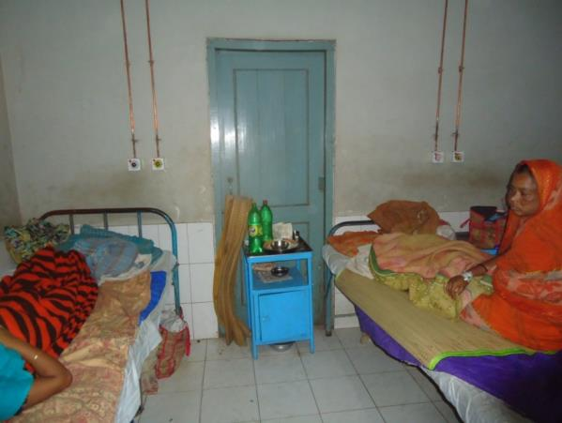
Before & After Situation
Before
After
Before
After

Slide 22





Before & After Situation
Before
After
Before
After

Slide 23


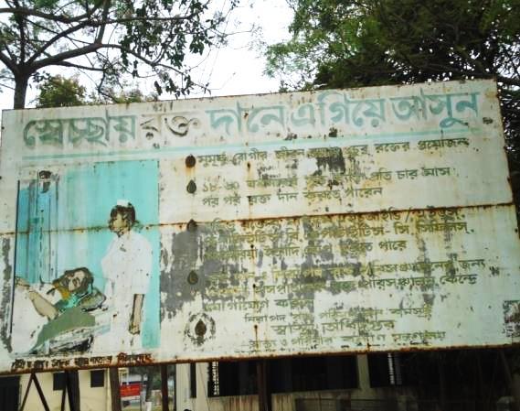
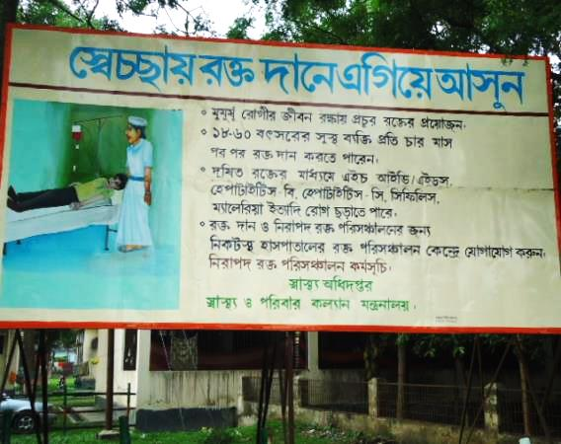
Before & After Situation
Before
After
Before
After

Slide 24

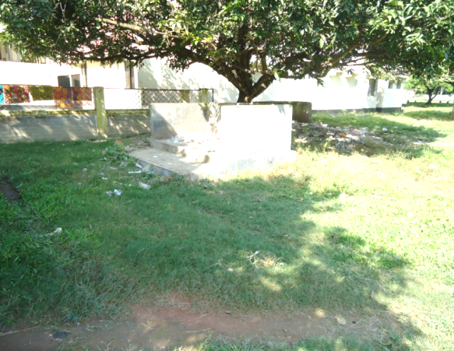


Before & After Situation
Before
After
Before
After

Slide 25




Local Govt. (Paurashava) Participation
Before
After
Before
After

Slide 26


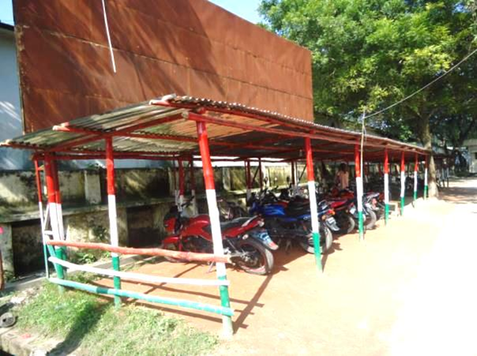

Present Environment of Hospital Campus
Complain &
Suggestion Box

Slide 27


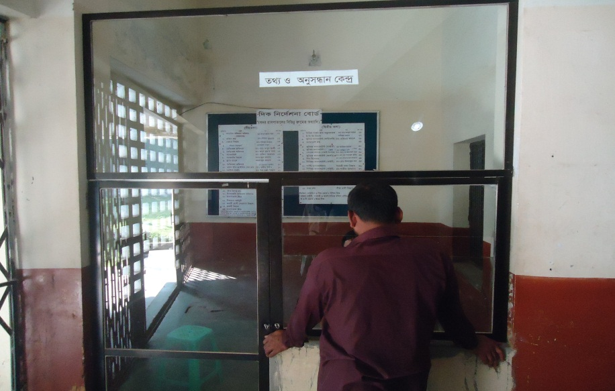
Community Donated Manpower & Logistics

Slide 28

Thank you
Notes:
28

Slide 29
Situation of the hospital in May 2012 -1
Unprotected Campus
a. Addicted person moved here and there at day and night.
b. Campus unclean goats and cows moved everywhere in day.
c. Front of the hospital was full of posters.
d. Broken cycle stand and there was a shade of polythin in front of the cycle stand.
e. Vesoz Garden was unclean and full of hospital waste.
Emergency:
a. Full of broken lockers
b. Unhygienic
c. Used as a cycle store at night.
d. No boiling system. Infection control system was neglected.
e. Addicted person worked in emergency department.
f. No trolleyman.
g. No slopping for trolley in front of the emergency department.
h. Privacy was neglected during stomach wash of the patient.
i. Corruption was not prevented.

Slide 30
Situation of the hospital in May 2012 -2
3. Outdoor:
a. No patient separation. Male female and child treated in outdoor by every outdoor doctor.
b. No IMCI Corner. c. No FP Unit.
Blood Bank:
a. No worker for 24 Hours blood bank support.
5. Indoor:
a. Unwanted items within the ward. Like broken patient bed.
b. Unhygienic environment.
c. Patient in paying cabin and paying ward without govt. charge.
d. No table and chair in paying cabin.
e. Non Govt. worker would take charge from the patient and some of the govt. workers also involved in corruption.
6. Dead body room:
a. Unclean.
b. Unused large telephone box for 10 years.
c. Workers would take heavy charge from the relatives of the dead person.

Slide 31
Situation of the hospital in May 2012 -3
EOC ward:
a. Only 4 govt. bed and 4 extra. Total 8 beds.
b. The ward was unhygienic and foul smelling.
c. Privacy was neglected.
d. ANC Corner system ineffective.
e. One washroom with broken door.
f. No rexin sheet and unclean mattress of the beds.
g. Mal use of oxytocic drug.
h. Weak infection control system.
i. Consultant reside outside the campus.
j. No health education system.
k. No pre labour room.
l. No night round of the consultant.
OT:
a. Some of the none govt. workers would take charge from the patient.
No round of superintendent of the hospital even one in a month.
No RMO, in charge RMO worked for six years.
Information display system was neglected.
One super were charged by local MP and one super fled away.
Frequently, Hospital stuffs faced physical and mental torture.

Slide 32
How we overcome the challanges
1. Situation analysis and prepare a baseline survey report in June 2012 and compared the progress with the baseline report of 1998.
a. Problem identification.
b. Basic activities.
c. Govt. resources
d. Scope
2. Motivation of doctors, nurses and staff.
3. Community motivation and social mobilization.
a. Local administration DC ADC
b. District health improvement committee which is headed by local MP.
c. Local Govt. Mayor, district chairmen.
d. Reporters and media personalities.
e. Social workers, Human Rights Organizations, few NGO, teachers, industrialists , TIB.
4. Improved cleanliness and beautification of the outer environment.
a. Involvement of Mayor. Ensure security of the campus and regular removal of hospital wastes, cleanliness of the drainage system.
b. Removal of all posters.
c. Made a boundary wall.
d. Starting for the beautification of the campus.
e. Celebrate A Big Cleaning Day in 17th March, the birthday of the father of the nation.

Slide 33
How we overcome the challenges -2
5. Reform of EOC program:
  -Introduce Labour Admission Register, Labour Ward Admission Form, Separate Discharge Form.
  -Starting of ANC & PNC corner and Arrange a Room for Medical Officer.
  -NO. of EOC Bed increase from 10 to 21 though on EOC bed only 5.
  -Improve EOC Operation Theater.
  -Moral based environment with 12 (twelve) workers supported by community donors.
  -EOC Operation activities extended from 8 A.M. to 2 P.M to 8 P.M.
  -Ensuring Rational use of drugs in EOC ward.
  -Provision of Mobile Phone in EOC ward no. 01857935012.
  -Shoe-free environment for infection control.
  -The center is used as a effective training center for SBA, Nursing student, Mid- wifiry.

Slide 34
How we overcome the challenges -3
6. Changes in Emergency
a. Removal of all unnecessary items.
b. Improved infection control system.
c. Transfer the addicted person from emergency,
d. EMOS room is reformed.
e. Arrange 3 trolley men.
f. Tiles fitting of the walls of emergency department.
g. Ensure privacy.
h. Make a slope for easy carry of the patient.
7. Changes in outdoor:
a. Separation of the outdoor patient. Male, Female, IMCI corner.
b. Opening of family planning section.
c. Opening of one step crisis service.
d. Opening of one cash counter and another delivery of report system.
Change in dead body room:
a. Removal of telephone box.
b. Ensure clean environment.
c. Prevention of corruption.

Slide 35
How we overcome the challenges -4
9. Changes in blood bank:
a. 24 hours blood bank service by the support of blood bank rule.
10. Changes in G OT
a. Arrange Generator.
b. Prevent corruption.
c. Beautiful OT environment.
11. Changes in indoor:
a. Improve cleanliness.
b. Arrange tiles at the wall of the female medicine indoor.
c. Removal of unwanted items.
d. Coloring of the patient beds, locker.
e. Arrange 3 ayah and 3 cleaner in every ward.
f. Table an chair supplies in every cabin for the patient.
.

Slide 36
How we overcome the challenges -5
12. Community support system.
a. Manpower, b. logistics, c. security system.
13. Improved MIS and Display system.
14. Improved supervisory authority.
a. District health development authority.
b. Ensure monthly meeting.
c. Formation of QIT and WIT team.
d. Idea sharing with Satkhira District Hospital visit.
e. Coordination with officials of DGHS, Ministry of Health and Family Welfare, BPATC Savar, Divisional Health Office, ICDDRB and JAICA.
15. Achievements:
a. Active community participation.
b. High performance of EOC program.
c. Improved cleanliness and beautification.
d. Ensure security.
e. Improved revenue income.
f. Achieve overall community satisfaction.

